Slide 1


Slide 2
Derbyshire Catering Service
Derbyshire Catering Service serves over 50,000 meals per day across schools in Derbyshire.
We want to take children on a food adventure and give them the confidence to become Food Explorers.
Our menu reflects a balanced diet, exceeds the School Food Standards and includes local produce.
For those children with medical diet requirements we offer a tailored menu, please ask your catering supervisor for more information.

Slide 3



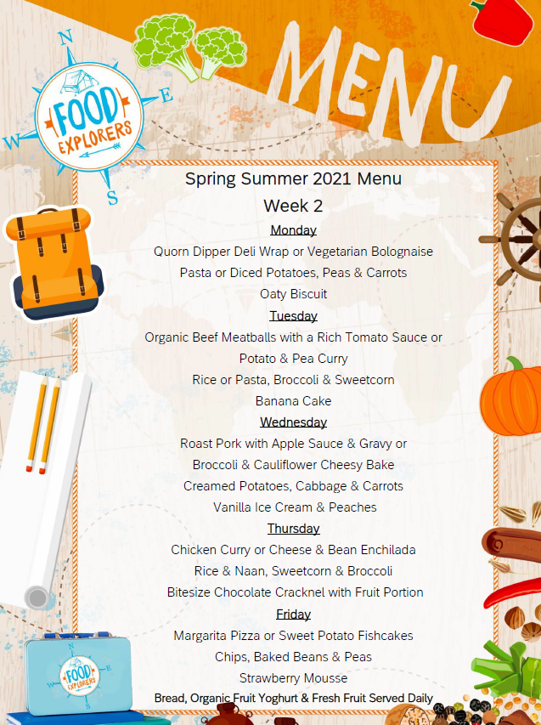



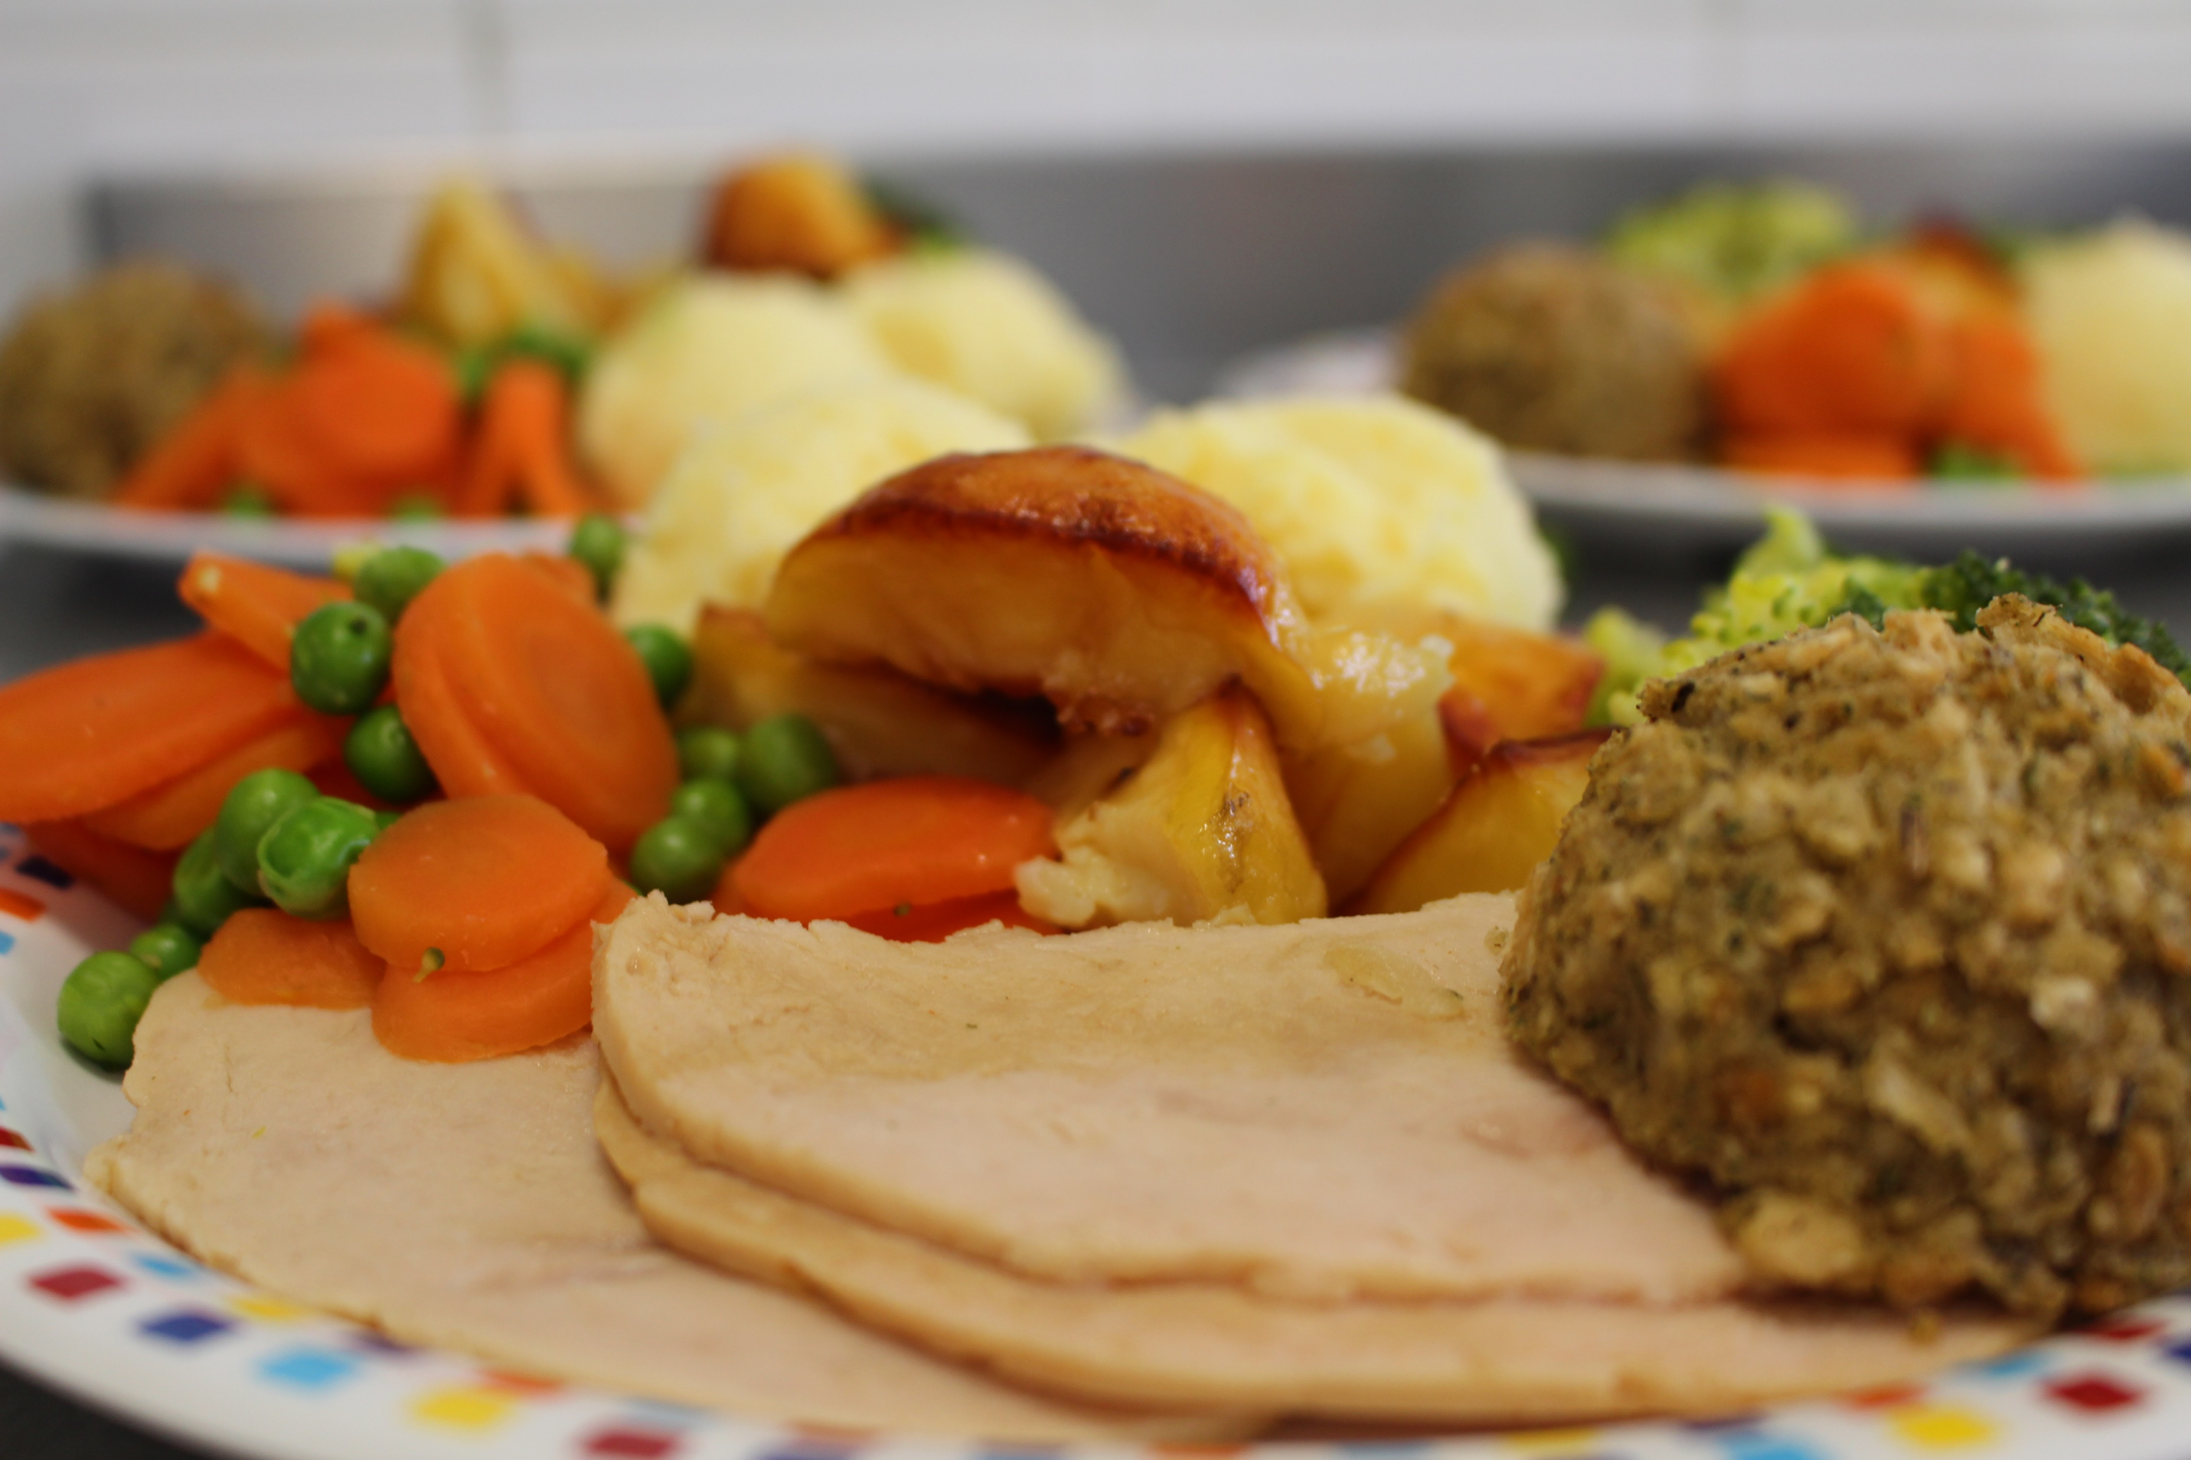

Slide 4
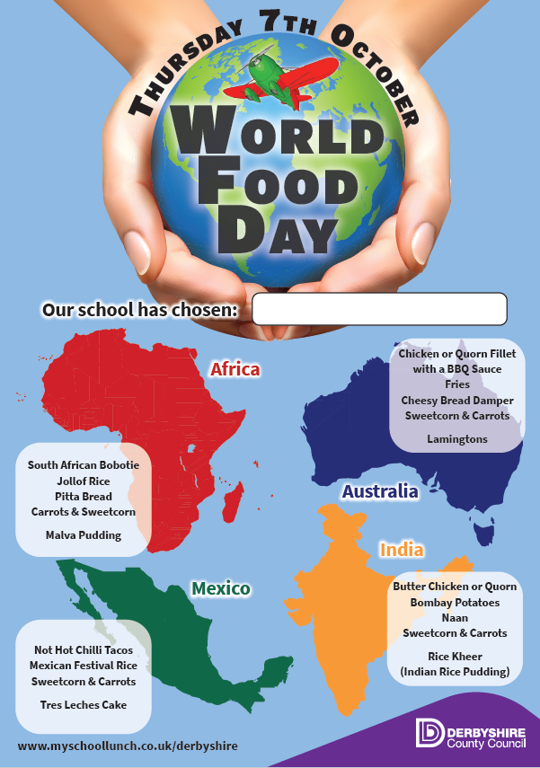
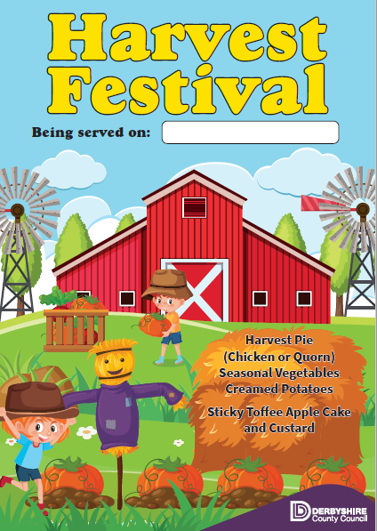
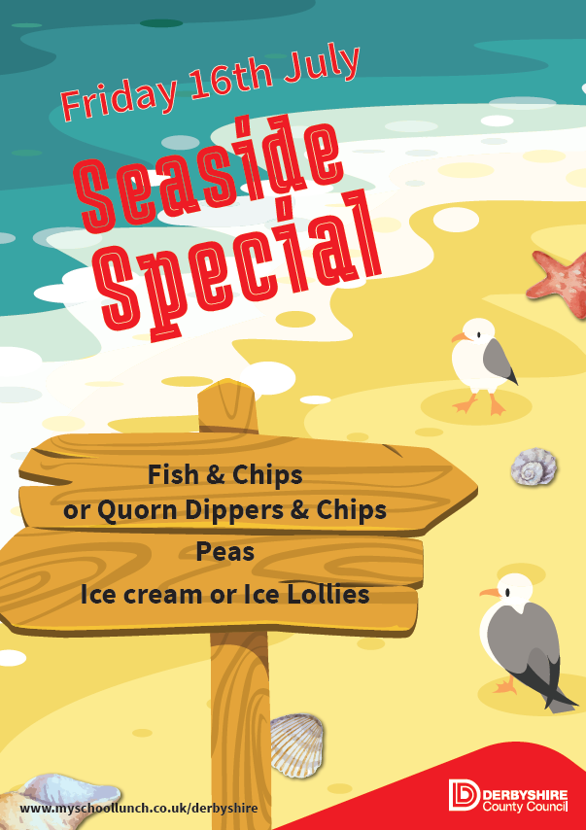
Theme Days
We think that lunchtime should be a highlight of the school day so each month we offer a new Theme Day menu, here are some examples.

Slide 5
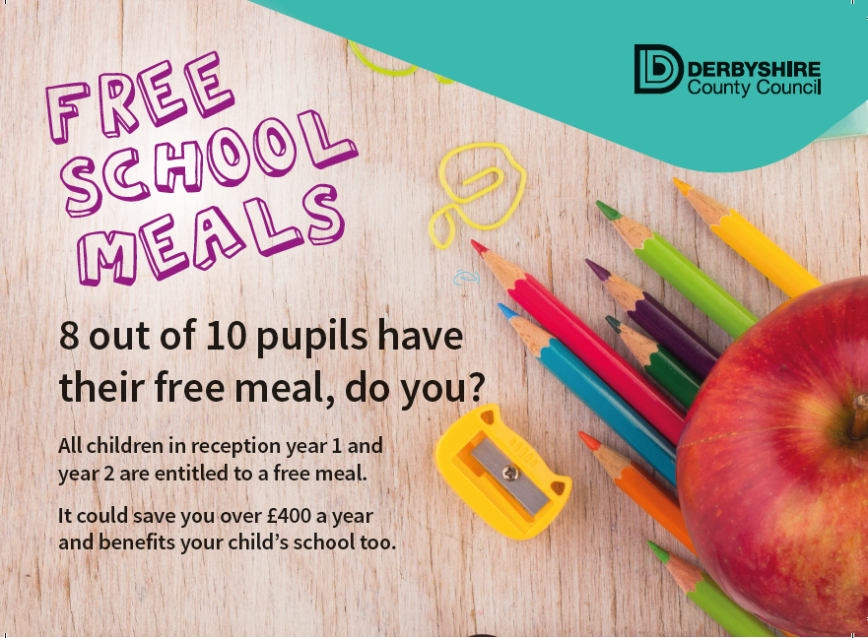
Free School Meals
All children in reception, year 1 and year 2 are entitled to a free meal.
More families than we have ever previously recorded are benefiting from free school meals.
It is quick and easy to find out if your family are eligible.
You can do this online, ask in school for an application form or contact the team by telephone 01629 536481 or by e-mail at checking@derbyshire.gov.uk

