Slide 1

YOUR CHILD IS STARTING RECEPTION…
Here are some things you will need to know.

Slide 2

A VERY WARM WELCOME TO COTMANHAY INFANT AND NURSERY SCHOOL
We are delighted that your child is joining our Reception either to continue their learning journey from Bears, or as a new starter.
We have put some information together in this presentation that will give you an overview.
Any questions please just contact us and ask.
It is important that we work closely with you to get the best experience for your child, you know them best!
We will be in contact with you about starting dates, timings, where to bring and collect your child and what they will need each day.
There are always lots of forms to fill in and we love getting them back quickly!
Please remember to make sure we always have your latest contact details, especially your email address.
We know and understand how emotional starting school is for your child and for you, we will do everything we can to make this as smooth as possible.
https://www.cotmanhayinfants.co.uk/

Slide 3
UNIFORM
Grey / black trousers / shorts
Grey / black skirt / pinafore
White polo t-shirt
School shoes – easy to fasten
Gingham summer dress
Please avoid playsuits and tie up shoes
WE SELL IRON-ON LOGOS FOR £1.50
NAME EVERYTHING!
You can buy our school uniform online from: https://www.loopwear.co.uk/index.php?route=product/category&path=60_336

Slide 4

PE
Reception children do PE once a week and come to school in their PE kit
PE KIT: red PE t-shirt (school provide one free), black shorts / leggings / joggers and trainers
Children to wear red school jumper / cardigan with PE kits – no hoodies
Reception children also take part in Forest School activities

Slide 5

LUNCHTIME
Lunchtime is between 12:30 and 1:30
Each class has their own midday supervisor
For the first few weeks the teachers also stay with the class
Every child is entitled to a free lunch
Children can bring a healthy packed lunch instead
We will always let you know if your child eats less than half so please try not to worry
We ask you not to swap between school and packed lunches each day – please give us notice of any changes

Slide 6

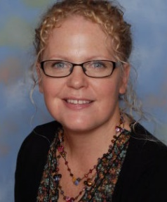
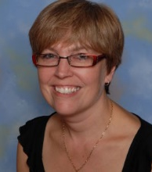
ROBINS CLASS
Miss Foster is the Robins Class Teacher.
Miss Foster is a Senior Leader and the Early Years Lead.
Mrs Taylor is the Robins Learning and Teaching Assistant.

Slide 7
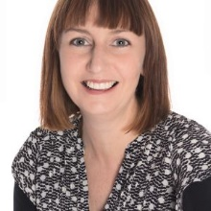

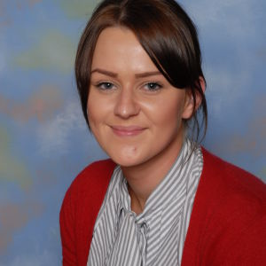
RACCOONS CLASS
Mrs Holmes is the Raccoons Class Teacher.
Miss Edwards is the Raccoons Class Learning and Teaching Asisstant.

Slide 8
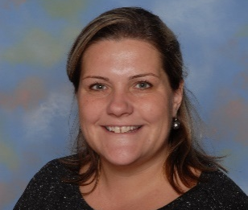
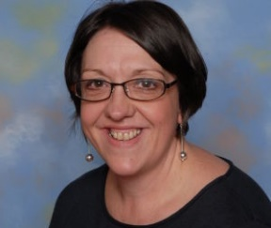
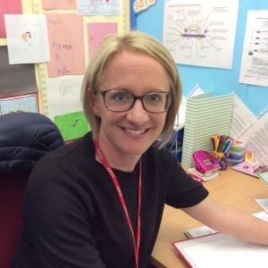
Who else will you see?
MISS LATCHFORD HEADTEACHER | MISS DAWSON DEPUTY HEADTEACHER AND SENDCO | MRS DELBRIDGE FAMILY SUPPORT WORKER
You will see us around each morning and afternoon. If you have any questions or need any extra support, please just ask. You can phone, email, dojo or make a time to meet with us.

Slide 9
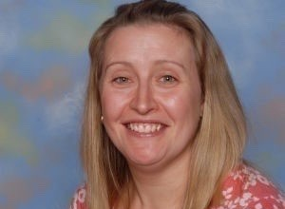
ATTENDANCE
Mrs Delbridge,
Family Support Worker
When your child starts Reception, it becomes law that they come to school every day and on time.
Children must be in school every day.
You must bring your child on time.
We regularly check attendance and if your child’s attendance goes below 96% you will get a letter letting you know what happens next.
If your child is genuinely unwell let us know.
Holidays are not allowed in school term time.
Try to get all appointments in the school holidays or after school.
Mrs Whitby,
Attendance Officer

Slide 10


LEARNING IN RECEPTION
Children in Reception classes are in the Early Years Foundation Stage of their education – in the Autumn term we will give you more information about what the children learn
All learning is taught through purposeful play
In reception children do a morning of English activities and then a morning of Maths activities on alternate days
We encourage independent confident learning inside and outside
Afternoons are flexible as we appreciate how tired young children can be
There is a lot of information about what children learn on our website:
https://cotmanhay-infant-school.secure-primarysite.net/our-eyfs/
HAVE A LOOK ON OUR WEBSITE – CLICK ON ‘RECEPTION’
https://www.cotmanhayinfants.co.uk/class-pages/

Slide 11

STAYING SAFE
All children must be accompanied at all times by an adult
Please let us know if you are going to be late to collect your child or if someone different is coming to collect your child
Children cannot be collected by under 14s
Dogs are not allowed on the premises
We have a behaviour policy for staff, children and parents
We ask all parents to sign a mutual respect agreement
We will ask and check things with you linked to your child – always tell us when they have an injury
Earrings must be removed or taped on P.E. days.

Slide 12

We hope you have found this helpful, any questions please contact us.
We will stay in touch with you as we all prepare for your child to join our Reception.

Slide 13
CONTACT DETAILS
Send us a message on dojo
Visit our website: www.cotmanhayinfants.co.uk
Phone us: 0115 9302064
Email us: info@cotmanhay-inf.derbyshire.sch.uk
Facebook: CotmanhayInfants
Twitter: CotInfants
Address: Beauvale Drive, Ilkeston, Derbyshire, DE7 8RR

